Slide 1
VECTOR DATABASE
Sneha Painuli [C0933116]
Amita [C0935607]
Japjeet Kaur (C0937720]
Manjot Kaur [C0938094]
Anju Bala [C0935847]
Nicolas [ C0922995]
Brian Martinez [C0940439]
Krishna Mohan Gadepalli [C0937251]
GROUP 6

Slide 2
🧠Why traditional databases fall short?
✅SQL/NoSQL database work well for structured data like:
-numbers(e.g., marks, salary)
-dates(e.g., DOB)
Strings(e.g., names, emails)
❌ But they struggle with unstructured data like:
📝Text documents
🖼️Images
🎧Audio
The main limitation:
-SQL/NoSQL can only perform keyword or exact value matches.
-They don’t ‘understand’ what the text or image is really about.

Slide 3
Introduce Semantic Search:Meaning-Based Search
Semantic search finds information based on the meaning of words, not just exact matches. For example, searching "automobile" also returns results like "car" or "vehicle", even if those exact words weren’t used.
Why is it powerful? It understands context and intent, going beyond simple keyword matching to deliver more accurate and relevant results.
💡 How it Works: It converts text into vectors—numerical representations of meaning—and compares these mathematically to find similar content.
✅ Real-World Use Cases: Used in Google Search, ChatGPT, YouTube recommendations, smart resume matchers, legal document search, and AI chatbots.

Slide 4
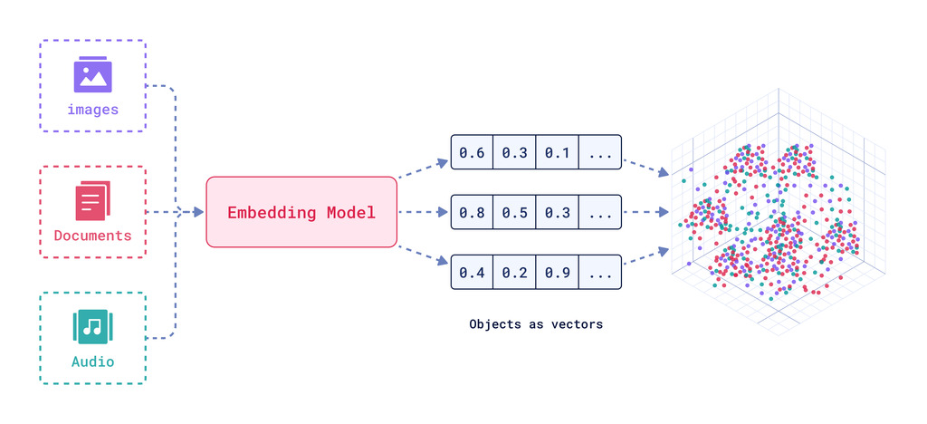
What is vector embedding ?
Vector embeddings are numerical representations of data points that express different types of data as an array of numbers that machine learning models can process.
In the embedding space, synonyms or similar kind of words (king or man, queen or girl) tend to appear in similar contexts and end up having similar embeddings.

Slide 5
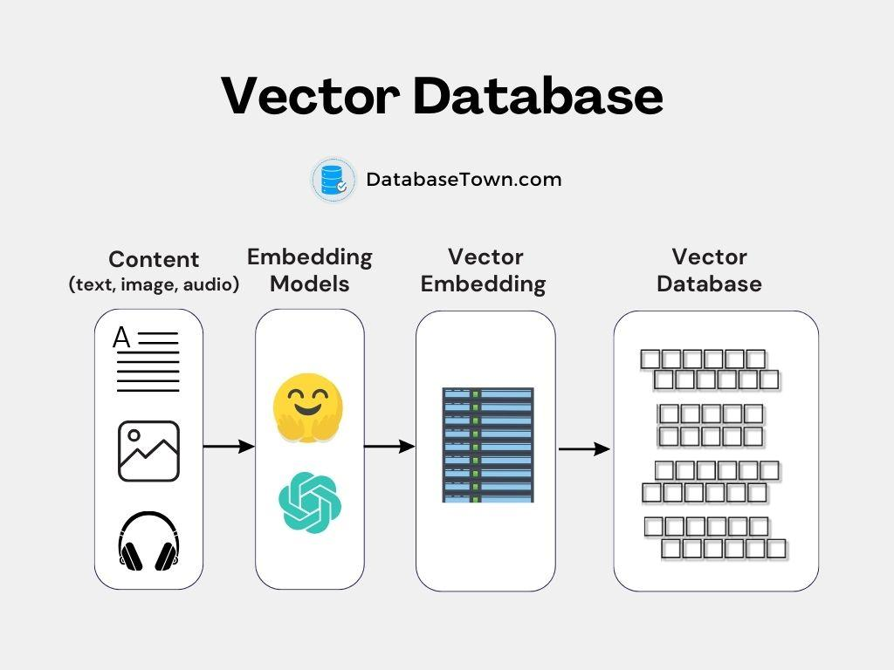
VECTOR DATABASE
A vector database is a specialized type of database designed to handle and process vectorized data,which are arrays of numerical values representing points in multidimensional space. A vector database indexes and store vector embeddings for faster retrieval and similarity search.

Slide 6
Advantages of vector database
Similarity search - quickly find similar items based on their features.
Scalability - handle large amounts of data efficiently.
Flexibility - works with various types of data like images, audio, video, and text.
Enhance performance - provide faster and more accurate search results.

Slide 7
USE CASE OF VECTOR DB
Recommendation systems—platforms like Netflix or Spotify use vector DB to recommend movies or songs based on your past preferences.
Image search - google images Use vector DB to find visually similar images.
Natural language processing - companies like OpenAI use vector DB to understand and generate human-like language to improve chatbots and translation services.
E-commerce - Amazon utilizes vector db to suggests products similar to the ones you have viewed or purchased

Slide 8

ChromaDB
An open-source, local-first vector database runs on your laptop or private server, no cloud dependency
Offers fast, private, and flexible data storage and retrieval
Converts complex data into high-dimensional vectors capturing semantic meaning
Supports advanced AI use cases such as semantic search, recommendation systems, and retrieval-augmented generation

Slide 9
How to Use ChromaDB Vectors
It can work on both python as well as javascript
Generate Embeddings Convert your raw data into vector form using an embedding model.
Create a Collection Make a container in ChromaDB to hold your vectors and metadata.
Add Data to Collection Insert embeddings, metadata, and unique IDs into your collection.
Query with Vector Convert a search input into a vector and search for similar vectors in the collection.
Retrieve Results Return the most similar items and use them in applications like semantic search or RAG.

Slide 10
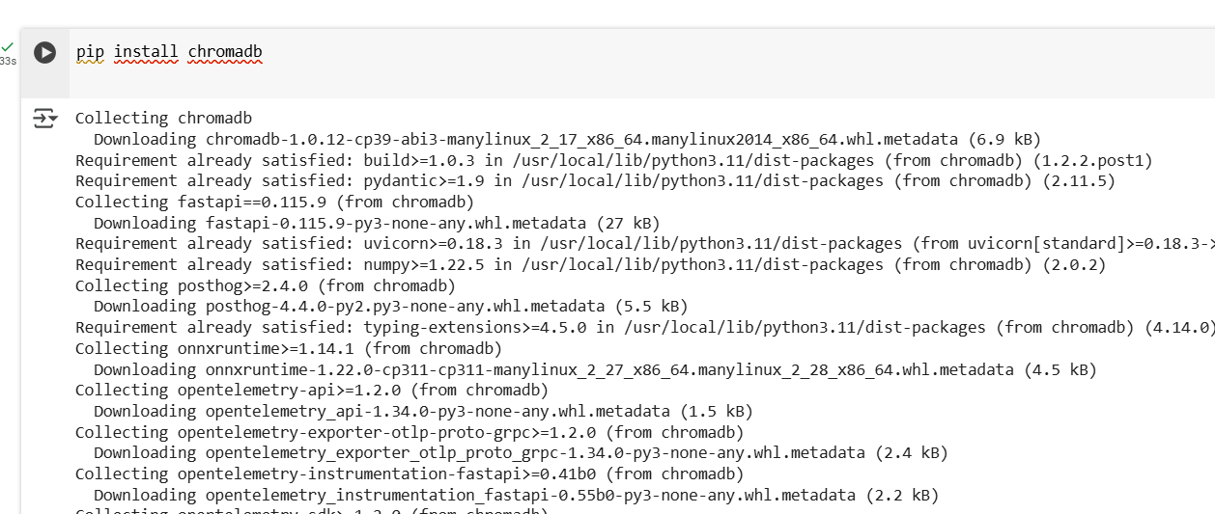

Steps to use ChromaDB vector
Step 1. Install chromadb step 2. Create a Chroma Client
PythonTypescript
Py

Slide 11
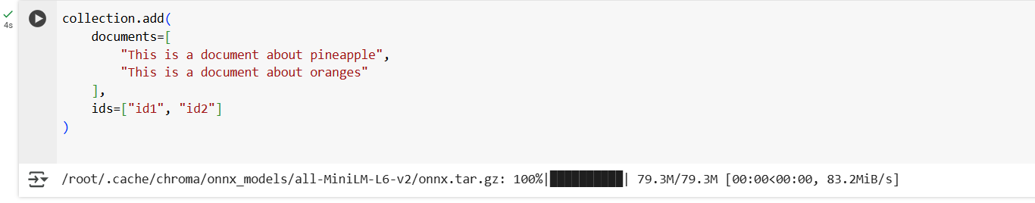
Step 3 create a collection:
Collections are where you'll store your embeddings, documents, and any additional metadata.
Step 4: Add some text documents to the collection
Chroma will store your text and handle embedding and indexing automatically. You can also customize the embedding model. You must provide unique string IDs for your documents.

Slide 12
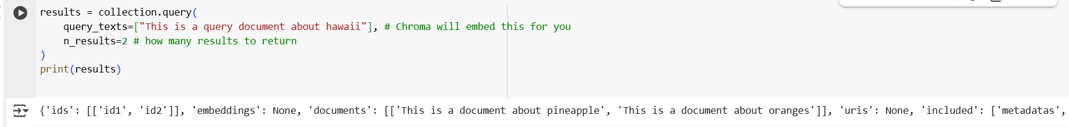
5. Query the collection
You can query the collection with a list of query texts, and Chroma will return the n most similar results. It's that easy!
If n_results is not provided, Chroma will return 10 results by default. Here we only added 2 documents, so we set n_results=2.

Slide 13
Key Features
Local-First & Serverless Works on your own machine without the need for cloud or server setup.
Supports Multiple Similarity Metrics Use cosine, Euclidean (L2), or inner product for flexible vector comparison.
Metadata Filtering Combine structured filters (e.g., tags, categories) with semantic search.
Python API Integration Easy to use with clean Python syntax for developers.
Fast & Lightweight Optimized for low-latency search — great for prototyping and AI apps.

Slide 14
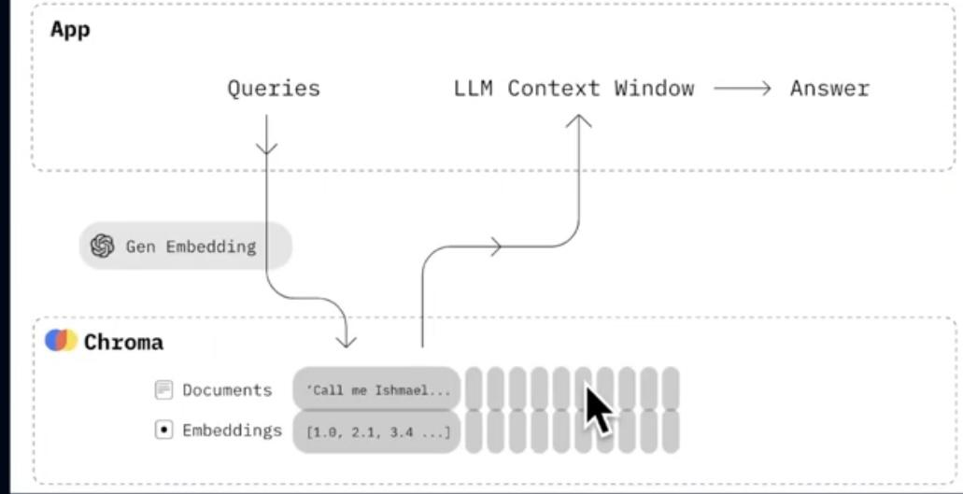
ChromaDB in RAG Architecture
RAG Overview: Combines vector search with language models to generate context-aware responses.
ChromaDB's Role: Stores and retrieves relevant document embeddings based on user queries.
Workflow Steps:
User submits a query.
Query is converted into a vector (embedding).
ChromaDB retrieves semantically similar documents.
Retrieved documents are provided to the language model.
Language model generates a response grounded in retrieved context.

Slide 15
Applications of ChromaDB in RAG Architectures
Enables document-based question answering by retrieving relevant text chunks.
Powers intelligent chatbots with long-term memory using vectorized history.
Supports enterprise knowledge assistants for HR, IT, and internal support queries.
Assists in legal and healthcare document retrieval based on semantic relevance.
Enhances academic research tools for faster literature discovery and comparison.
Drives semantic product recommendation systems using vector similarity.

Slide 16
ChromaDB is Best For:
🔍 Semantic Search Finding relevant documents based on meaning, not exact keywords.
🤖 Retrieval-Augmented Generation (RAG) Supplying external knowledge to LLMs for accurate, grounded responses.
🎯 Recommendation Systems Suggesting items based on vector similarity (e.g., products, content).
🔗 Hybrid Search Combining metadata filters (like SQL) with vector similarity for more precise results.
🧪 Prototyping AI Applications Fast, local setup for building LLM apps, chatbots, and intelligent search tools

Slide 17
❌ ChromaDB is Not Ideal For:
🧱 Very Large-Scale Deployments Not yet optimized for billions of vectors or massive production-scale workloads (use FAISS or Pinecone instead).
🛢️ Traditional Relational Data Queries Doesn’t support complex SQL joins, aggregations, or transactions like PostgreSQL or MySQL.
🕒 Heavy Real-Time Streaming Ingestion Not designed for high-frequency, continuous real-time data ingestion pipelines.
⚙️ Advanced Index Customization Offers limited control over indexing techniques compared to FAISS (e.g., IVF, PQ, HNSW tuning).
🧠 Deep Model Integration Doesn’t handle training or fine-tuning models—only works with pre-computed embeddings.

Slide 18
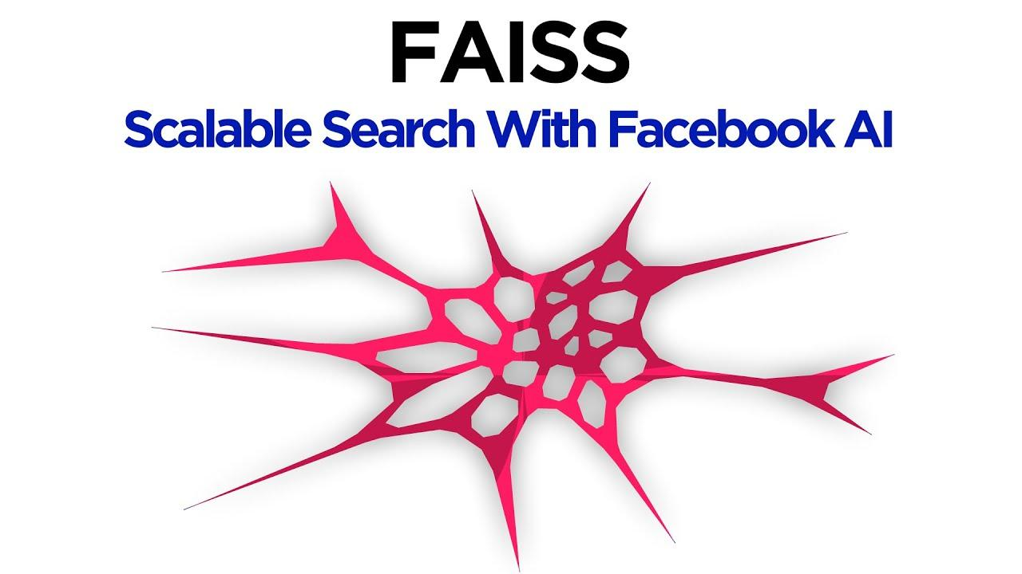
FAISS?
FAISS stands for Facebook AI Similarity Search
Developed by Facebook AI Research as an open-source library
Designed for fast and scalable similarity search on high-dimensional vectors
Supports efficient search on billions of vectors using CPU and GPU

Slide 19
Why is Vector Similarity Search Important?
Many ML models output embedding vectors (e.g., word embeddings, image features)
To find similar items, we search for nearest neighbors in embedding space
Example: Given a query sentence embedding, find most similar documents
Brute force search is slow and computationally expensive at large scale

Slide 20
Challenges in Large Scale Similarity Search
Dimensionality: vectors often have hundreds to thousands of dimensions
Dataset size: millions to billions of vectors
Time complexity of naive search: O(N) per query, too slow for large N
Need for approximate nearest neighbor (ANN) search to balance speed and accuracy

Slide 21
What FAISS Offers
Highly optimized similarity search algorithms in C++ with Python bindings
Supports:
Exact nearest neighbor search
Approximate nearest neighbor search with trade-offs
GPU acceleration to massively speed up searches
Multiple indexing strategies tailored for various dataset sizes and accuracy needs

Slide 22
Key Index Types in FAISS
Index Type | Description | Advantages | Use Case / When to Use
IndexFlatL2 | Exact brute-force search using Euclidean (L2) distance. Stores all vectors and compares all. | - Simple, no training needed- 100% accurate results | - Small datasets (thousands to low millions)- Baseline or testing- When accuracy is critical and dataset fits in memory
IndexIVFFlat | Inverted File Index: clusters vectors using k-means, searches only in closest clusters. | - Faster search by limiting candidates- Scales to millions | - Large datasets (millions to billions)- When faster search with some accuracy loss is acceptable
IndexHNSW | Graph-based index building a navigable small world graph to perform approximate nearest search. | - High recall with fast search- No training needed | - Medium to large datasets- When speed and accuracy both matter- Real-time applications requiring low latency
IndexPQ | Product Quantization compresses vectors into compact codes, reducing memory and speeding search. | - Significant memory savings- Fast approximate search | - Very large datasets that cannot fit in RAM- Memory constrained environments- Use with IVF for combined benefits
Hybrid Indexes | Combines methods like IVF + PQ to balance speed, accuracy, and memory use. | - Tunable trade-offs- Efficient indexing and searching | - Large-scale applications with strict latency and memory requirements- Production-grade search systems

Slide 23
Advantages of FAISS
High-speed vector search at scale
Supports multiple indexing and compression techniques
Open-source, well-maintained by Facebook AI Research
Python-friendly API with C++ backend for speed
GPU acceleration for demanding use cases

Slide 24
LIMITATIONS
Memory Intensive:Large datasets must fit in RAM or GPU memory.
No Native Delete Support:Removing vectors is complex and not efficient.
No Persistence: Must manually save/load index files.
No Metadata Storage :Stores only vectors, not associated text or info.
Single-Node Only: No built-in support for distributed or multi-node setups.

Slide 25
Real-World Use Cases
Meta (Facebook):
Facial recognition
Video deduplication
Image search
Spotify:
Music recommendation via audio embeddings
RAG (Retrieval-Augmented Generation):
Use FAISS to store document embeddings.
Retrieve relevant documents to feed into LLMs.

Slide 26
RAG Architecture with FAISS – Applications
1️⃣
Customer Support Chatbots: Fast retrieval of relevant FAQ or knowledge base answers from millions of documents.
2️⃣
Legal Document Retrieval: Enables similarity-based search across large corpuses of legal contracts or case law.
3️⃣
Healthcare Q&A Systems: Accurately fetches medical literature or patient documents for doctor/patient queries.
4️⃣
E-commerce Search & Recs: Powers semantic product search and personalized recommendations at large scale.
5️⃣
Enterprise Knowledge Search: Efficiently indexes internal documents (emails, reports) and retrieves contextual answers.
6️⃣
Developer Assistants: Retrieves code snippets, documentation, and solutions using semantic similarity.

Slide 27
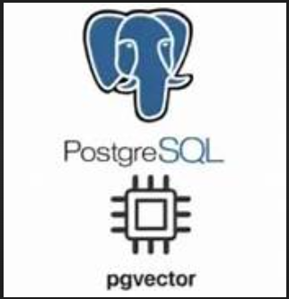
PgVector
A PostgreSQL extension for vector similarity search
Enables storing and querying dense embeddings
Use Case:
Semantic search, RAG, recommendation, hybrid SQL+vector search
Key Features
Works inside PostgreSQL
Supports full SQL queries
Cosine / L2 / inner product distances
Combine filters + semantic search
IVFFlat for approximate ANN

Slide 28
pgvector is best for:
SQL + vector use cases
Simple deployments
Tight integration with metadata
Not ideal for:
High-scale, distributed retrieval
Time-sensitive memory (use ChronoMind)

Slide 29
How pgvector Works?
Stores embeddings using a VECTOR(n) column
Supports similarity metrics:
Cosine distance
L2 (Euclidean)
Inner product
Can use exact or approximate search (IVFFlat)

Slide 30
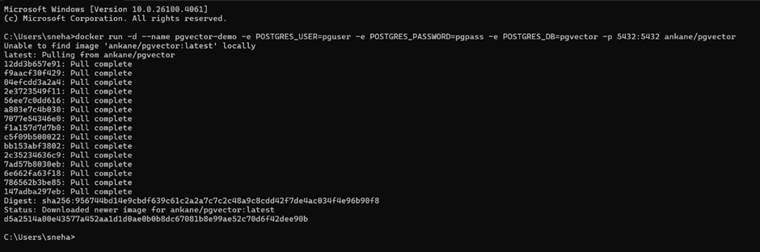
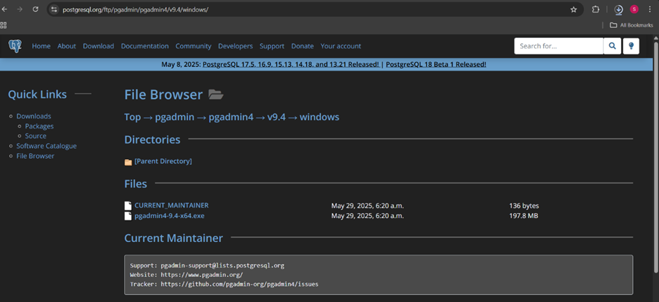
INSTALLATION AND SET UP
STEP 1:
STEP2:

Slide 31
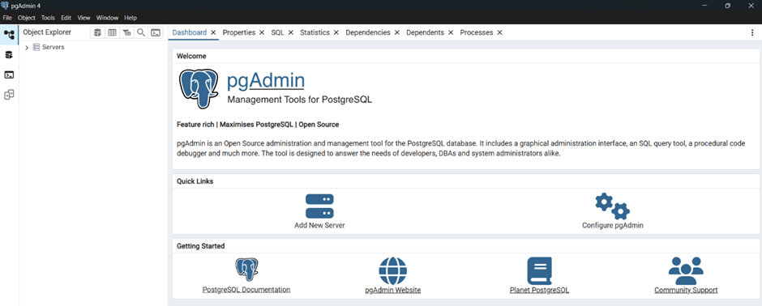
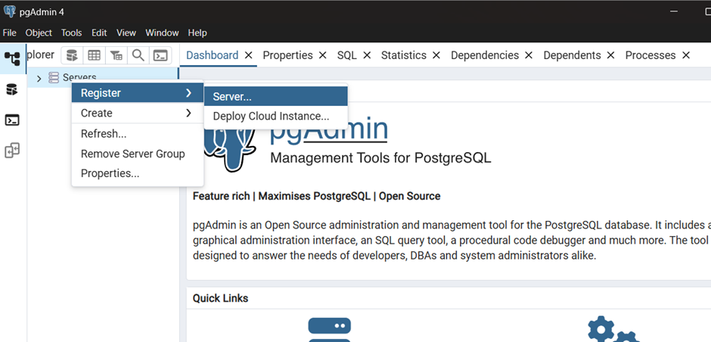
STEP 3:
STEP 4:

Slide 32
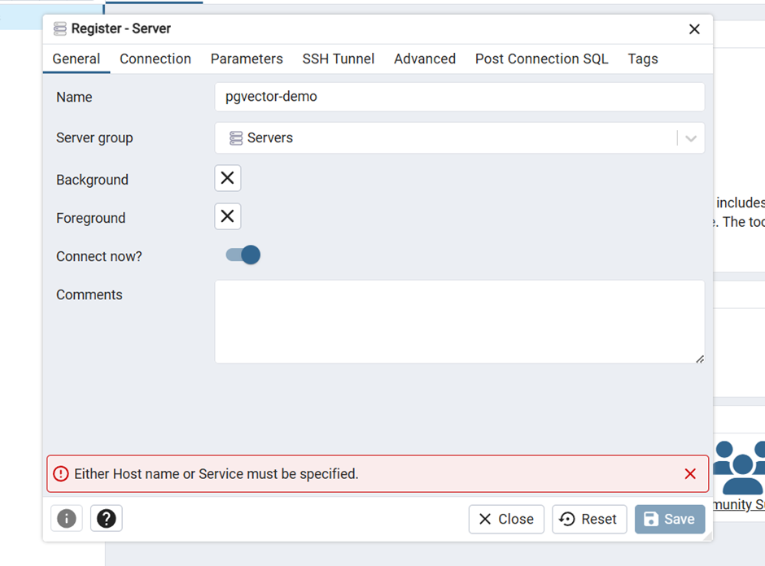
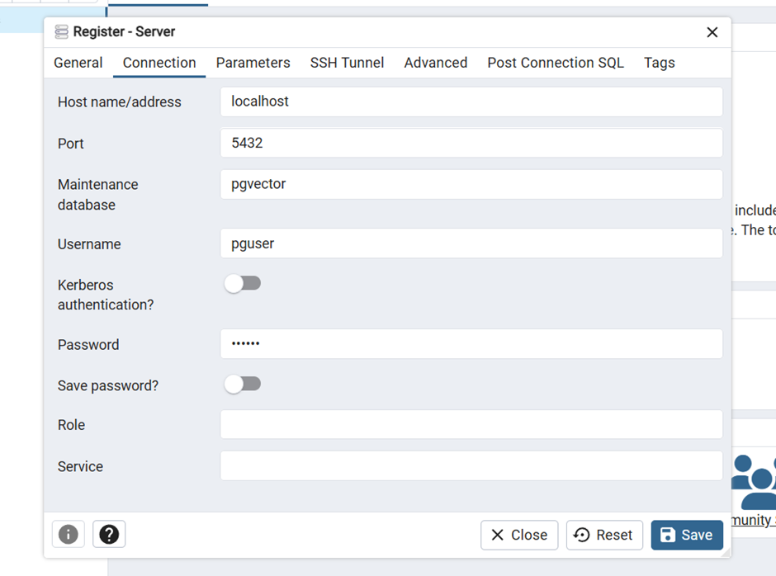
STEP 5:

Slide 33
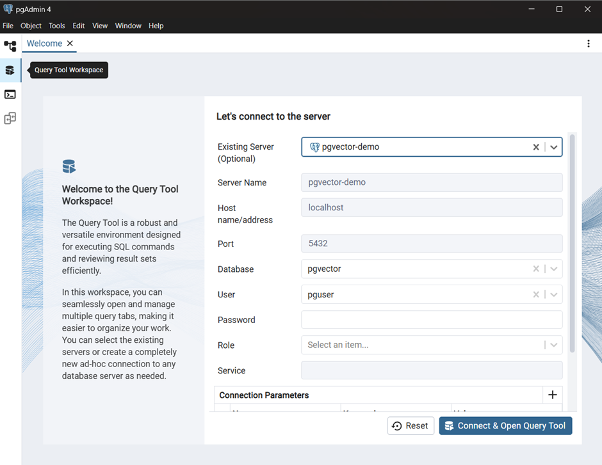
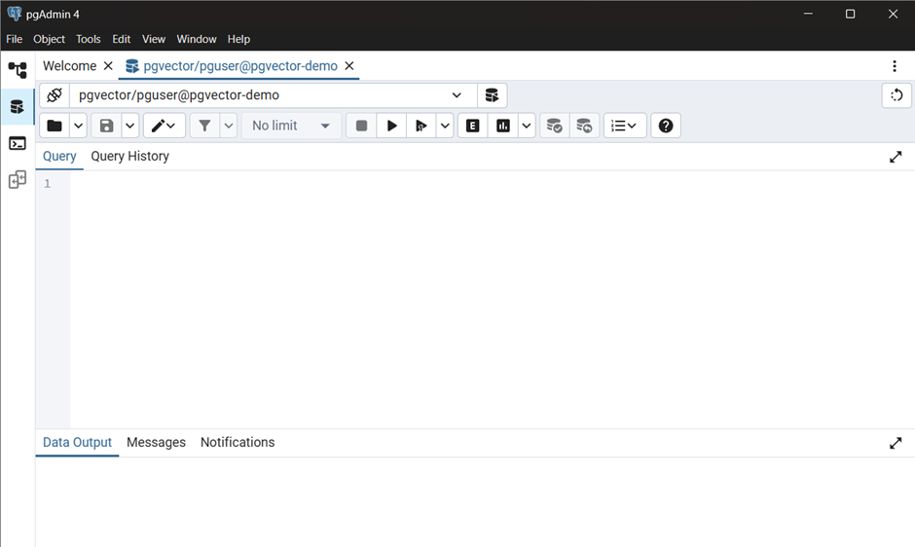
STEP 6:
STEP 7:

Slide 34
Advantages
Built into PostgreSQL—no extra infrastructure
Query vectors using simple SQL
Combine vector + metadata filters
Supports exact and approximate search
Easy to prototype RAG apps
Works with popular cloud Postgres providers ( Amazon RDS (PostgreSQL), Google Cloud SQL, Azure Database for PostgreSQL,etc).

Slide 35
Disadvantages
Not ideal for very large datasets
Slower than FAISS/ScaNN for ANN
No support for time-based relevance
Indexing (IVFFlat) must be managed manually
Requires tuning for optimal performance

Slide 36
When to Use pgvector?
Already using PostgreSQL
Want to filter + search (SQL + embeddings)
Building early RAG prototypes
Handling up to ~1M rows efficiently

Slide 37
Application in RAG
Generate text embeddings using OpenAI/Cohere
Store embeddings in PostgreSQL using pgvector
On query:
Convert input → vector
Run top-k similarity search using SQL
Feed results into the LLM

Slide 38
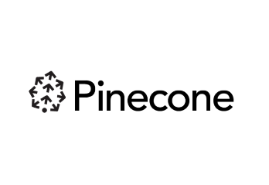
Pinecone
Pinecone is a fully managed vector database designed for similarity search.
It enables fast, scalable search across high-dimensional embeddings (text, images,
etc.)
Ideal for semantic search, recommendation systems, and RAG architectures.
Use Case: Retrieval-Augmented Generation (RAG)
Semantic search (text, image, code)
Personalized recommendations
Chatbots with long-term memory
Duplicate detection and anomaly detection
Key Features
Fully managed vector database as a service
Fast approximate nearest neighbor (ANN) search
Scalable to millions or billions of vectors
Built-in metadata filtering and namespaces
Supports real-time upserts, deletions, and updates
Simple REST API & Python SDK

Slide 39
Best For
Scalable RAG pipelines using OpenAI/BERT embeddings
Teams that want production-ready search without DevOps overhead
Applications needing real-time similarity search
Enterprises with cloud infrastructure (Pinecone is cloud-native)
Not Ideal For
Projects requiring fully offline or local-only setup
Open-source-only environments (Pinecone is closed-source)
Lightweight apps with very small vector datasets
Developers who want full control over vector indexing methods (FAISS gives more flexibility)

Slide 40
How Pinecone Works?
Stores vector embeddings (e.g., from BERT, OpenAI, SentenceTransformer).
Indexes them using approximate nearest neighbor (ANN) search algorithms.
Returns the most semantically similar vectors to a query embedding.
Supports metadata filtering and real-time updates.

Slide 41
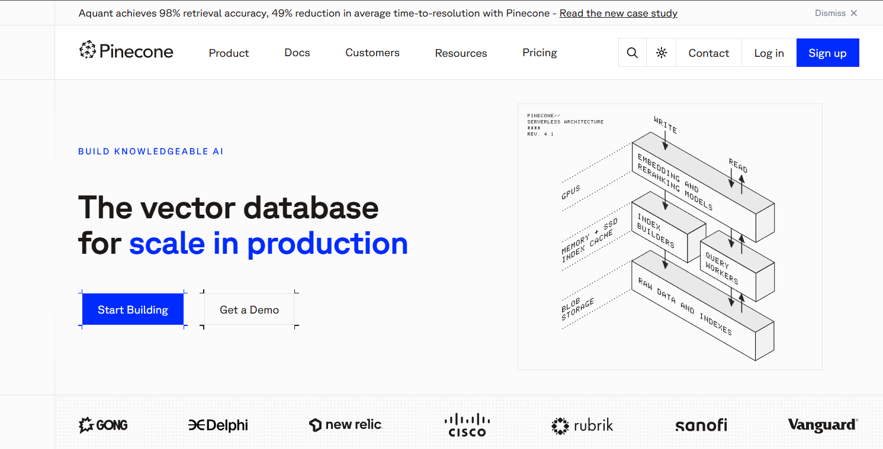
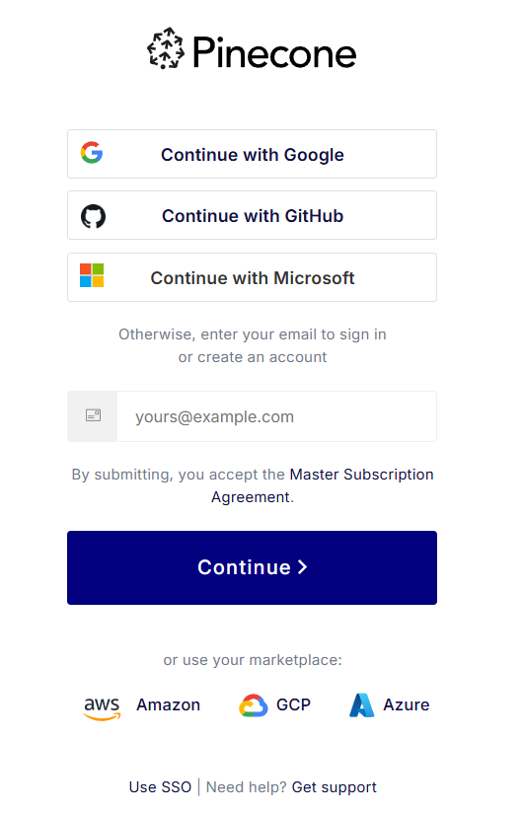
INSTALLATION AND SET UP
Go to 👉 https://www.pinecone.io
STEP 1:
STEP 2:

Slide 42
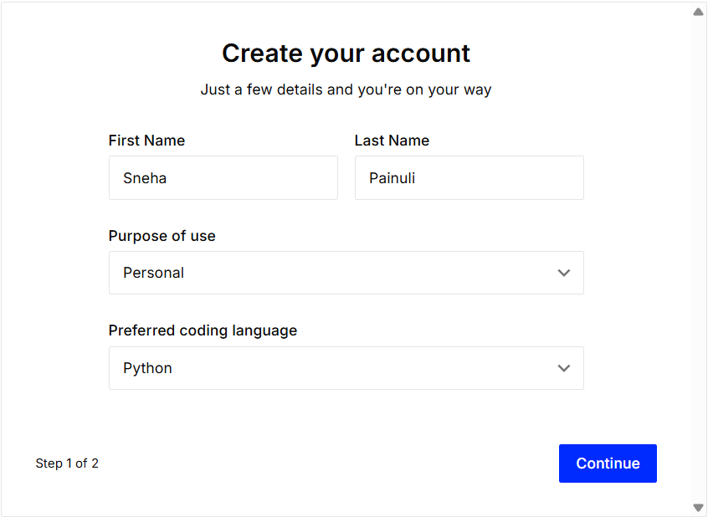
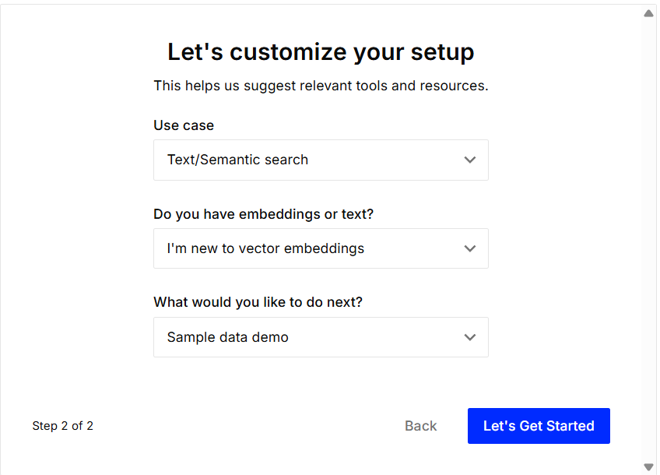
STEP 3:
STEP 4:

Slide 43
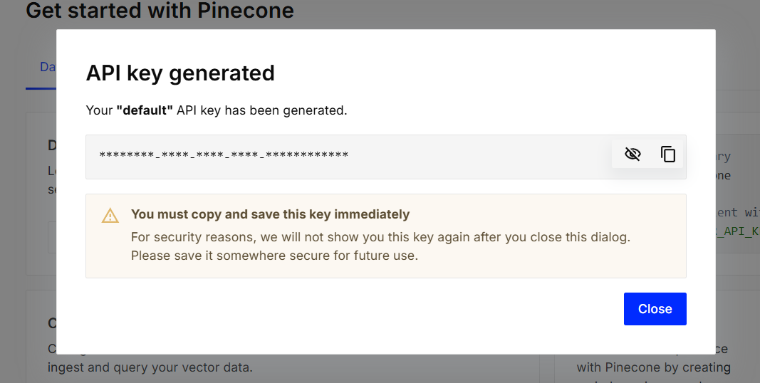
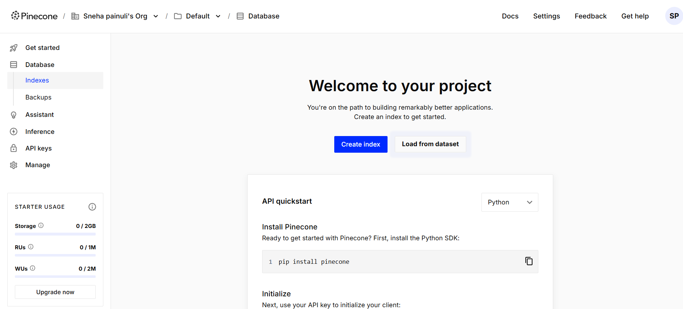
STEP 5:
STEP 6:

Slide 44
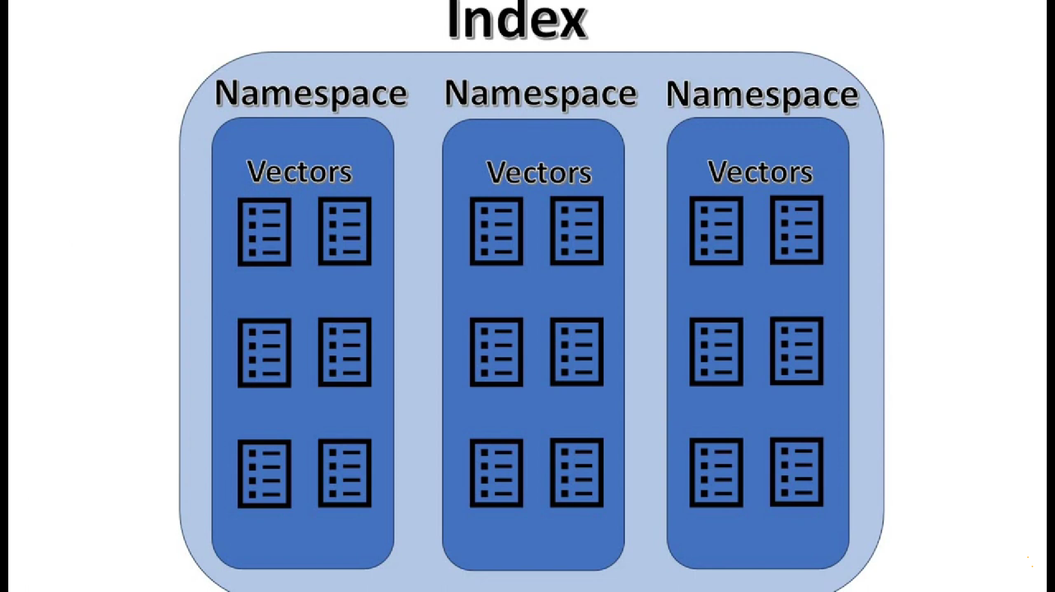
Components of Pinecone
1. Index
A container/database to store and manage all vectors.
Organizes data for efficient search and retrieval.
2. Namespace
A logical grouping inside an index (like a sub-folder).
Keeps datasets separate without multiple indexes.
3. Vector
A list of numbers representing data (text, images, etc.)
mathematically.
Enables similarity comparison between data points.

Slide 45
Advantages of Pinecone
Fully managed – no infrastructure maintenance.
Highly scalable – handles millions of vectors.
Fast and accurate vector similarity search.
Built-in metadata filtering and namespaces.
Real-time updates and low-latency search.

Slide 46
Disadvantages of Pinecone
Paid service – not open-source (free tier has limits).
Cloud-dependent – no fully offline/local version.
Less flexibility than open-source tools (e.g., FAISS).
Not ideal for small, lightweight/local projects.

Slide 47
When to Use Pinecone ?
Use Pinecone when:
You need production-grade vector search with minimal ops overhead.
You’re scaling to millions of documents or queries.
You want real-time search performance in a RAG system.
You prefer a plug-and-play API over managing FAISS manually.

Slide 48
Application in RAG
Stores text embeddings of documents or knowledge chunks.
When a user asks a question:
The query is embedded → sent to Pinecone.
Pinecone returns top-K similar chunks.
The retrieved context is passed to a language model for answer generation.
Enhances context relevance, reduces hallucination, and supports grounded generation.

Slide 49
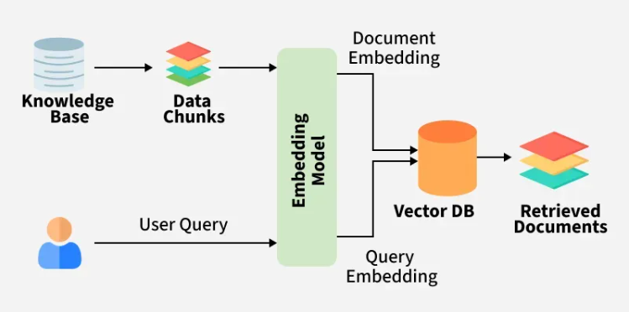
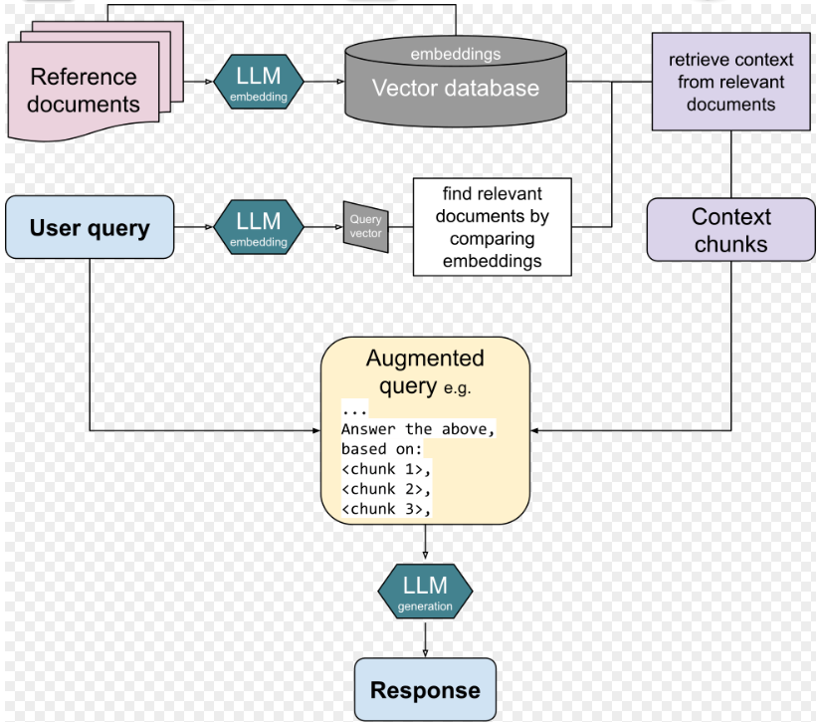
WORKFLOW
Embedding model
Embedding model

